Slide 1



TeamTime.
Shift scheduling is a pervasive requirement across many businesses.
numerous businesses in Israel manually manage their scheduling calendars, leading to errors, inefficiencies, and frustration for both employees and managers
investing valuable time in this process
Idan tal, Guy Hirsch, Yael Irony, Itamar Zand
Advisor: Prof. Niv Gilboa

Slide 2
Background
Customize and flexibly adapt requirements to meet business needs.
Save time, money & management resources.
Automate shift scheduling.
Providing one platform for shift scheduling.
Shift scheduling is a pervasive requirement across many businesses.
numerous businesses in Israel manually manage their scheduling calendars, leading to errors, inefficiencies, and frustration for both employees and managers
investing valuable time in this process
1
2
3
4

Slide 3
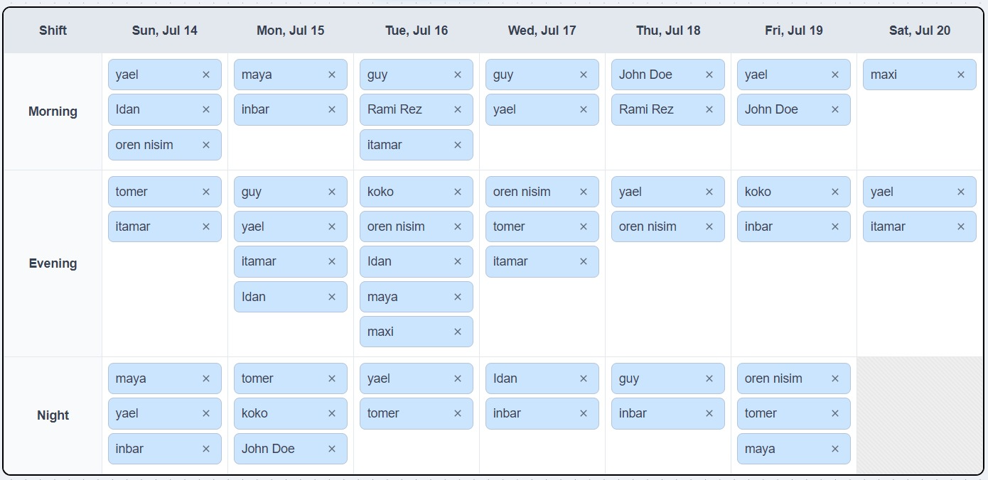
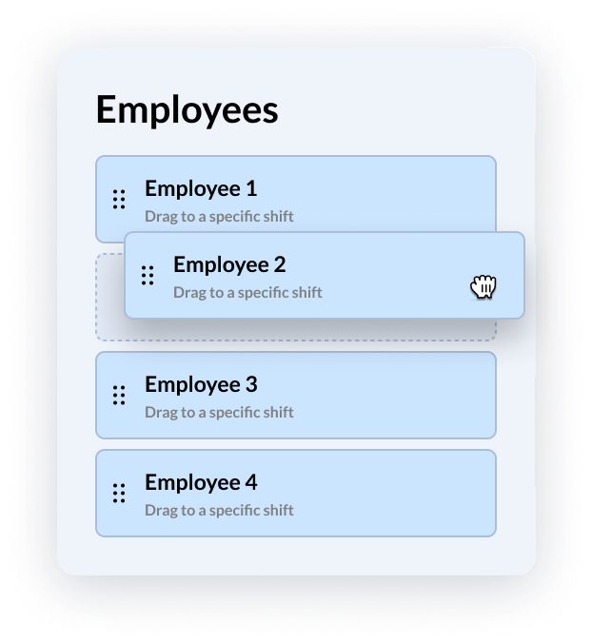



Our Main Goals
Providing one platform for shift scheduling.
Automate shift scheduling.
Customize and flexibly adapt requirements to meet business needs.
Save time, money & management resources.

Slide 4
Our Solution
Indroducing TeamTime
Our solution introduces a user-friendly, automated system utilizing an advanced linear programming algorithm to optimize scheduling.
Teamtime is designed to tackle the common challenges encountered by managers and employees, addressing their specific scheduling needs efficiently and effectively.
Traditional Methods
Relies on outdated techniques like manual spreadsheets, which are time-consuming and error-prone.

Slide 5




Weekly Flow:
Traditional Methods
Manager's Time and Efficiency
Employee Preferences
Balancing individual preferences with business needs is complex and challenging.
Creating schedules manually is extremely time-consuming for managers, reducing their efficiency.
Relies on outdated techniques like manual spreadsheets, which are time-consuming and error-prone.

Slide 6

Workflow:
Setup process
Administrators set staffing requirements and schedule next week's shifts according to business needs
Traditional Methods
Manager's Time and Efficiency
Employee Preferences
Balancing individual preferences with business needs is complex and challenging.
Creating schedules manually is extremely time-consuming for managers, reducing their efficiency.
Relies on outdated techniques like manual spreadsheets, which are time-consuming and error-prone.

Slide 7
Workflow:
Setup process
Employee Submit Shift
Administrators set staffing requirements and schedule next week's shifts according to business needs
Employees enter their preferred shifts and availability for the upcoming week using an intuitive interface
Traditional Methods
Manager's Time and Efficiency
Employee Preferences
Balancing individual preferences with business needs is complex and challenging.
Creating schedules manually is extremely time-consuming for managers, reducing their efficiency.
Relies on outdated techniques like manual spreadsheets, which are time-consuming and error-prone.

Slide 8

Workflow:
Setup process
Employee Submit Shift
Automated Scheduling
Administrators set staffing requirements and schedule next week's shifts according to business needs
Employees enter their preferred shifts and availability for the upcoming week using an intuitive interface
TeamTime's algorithm generates a schedule based on employee input, manager requirements, and business needs.
Traditional Methods
Manager's Time and Efficiency
Employee Preferences
Balancing individual preferences with business needs is complex and challenging.
Creating schedules manually is extremely time-consuming for managers, reducing their efficiency.
Relies on outdated techniques like manual spreadsheets, which are time-consuming and error-prone.

Slide 9
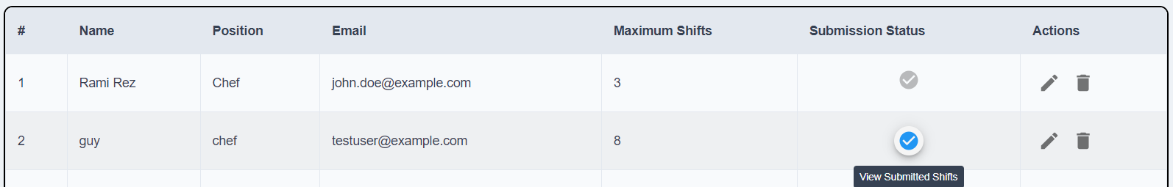
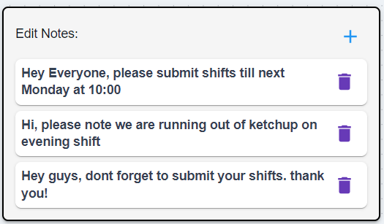

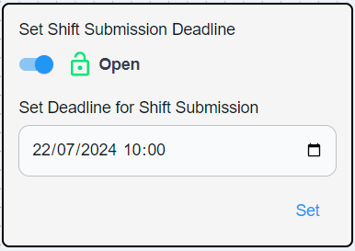
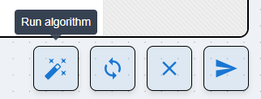
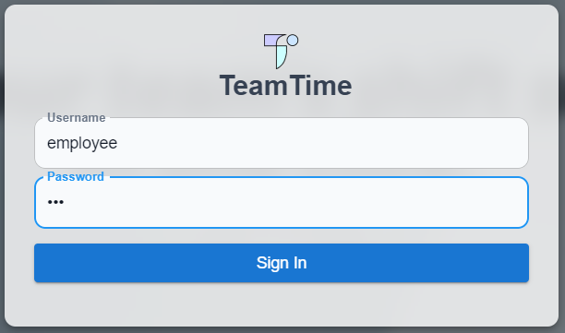
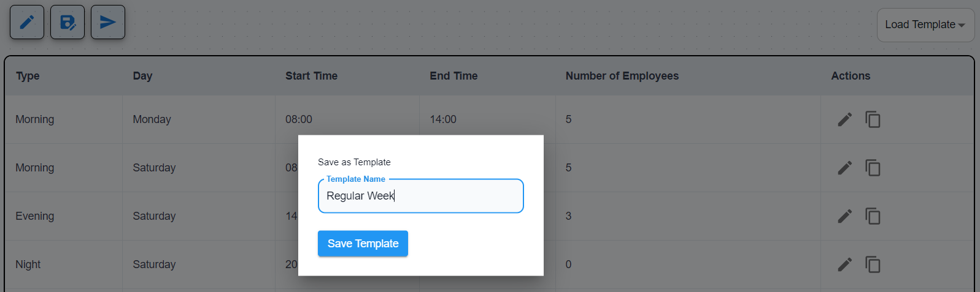
Submission Status
Admin Notes for Employee Communication
Workflow:
Enable Automated Submission Deadline
Setup process
Employee Submit Shift
Automated Scheduling
Admin Review and Publication
Administrators set staffing requirements and schedule next week's shifts according to business needs
Employees enter their preferred shifts and availability for the upcoming week using an intuitive interface
TeamTime's algorithm generates a schedule based on employee input, manager requirements, and business needs.
Administrators review, finalize, and publish the schedule, making it accessible to all employees.
TeamTime's Algorithm
Secure Login Page
Shift Template Management

Slide 10
Our algorithm utilizes linear programming to maximize shift coverage while meeting specific requirements.
The algorithm address employee requirements:
By incorporating constraints such as employee availability, maximum desired shifts, and a limit of one shift per employee per day, it ensures optimal scheduling.
The algorithm address admin requirements:
The number of employees per shift is considered as a constraint.
The objective function, aimed at maximizing shift coverage while maintaining operational balance.
Features
Submission Status
Enable Automated Submission Deadline
Admin Notes for Employee Communication
TeamTime's Algorithm
Shift Template Management
Secure Login Page

Slide 11
The Scheduling Algorithm
Our algorithm utilizes linear programming to maximize shift coverage while meeting specific requirements.
The algorithm address employee requirements:
By incorporating constraints such as employee availability, maximum desired shifts, and a limit of one shift per employee per day, it ensures optimal scheduling.
The algorithm address admin requirements:
The number of employees per shift is considered as a constraint.
The objective function, aimed at maximizing shift coverage while maintaining operational balance.

Slide 12

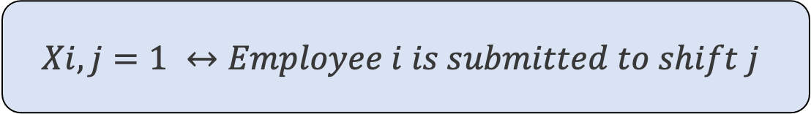
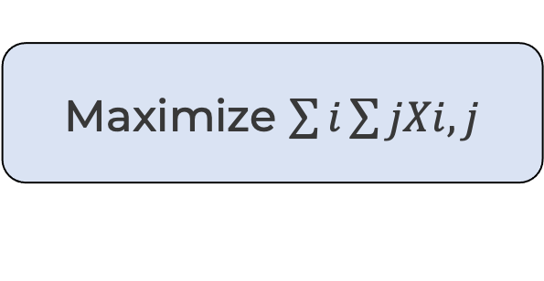
The Scheduling Algorithm
We will use variables to simply explain the algorithm in detail:
The index i denotes the i-th employee.
The index j denotes the j-th shift.
xi,j​ represents the submission of employee i for shift j.
Linear programming consists of variables, objective function and constrains.
Reminder
Ensure that for each shift, the number of assigned employees does not exceed the required number of employees per shift.
Ensure that each employee can only be assigned to one shift per day and manage blocked shifts.
Objective function
Linear Programmimg Output
Maximize $\sum{i}\sum{jXi,j}$
$$Xi,j=1 ↔Employee i is submitted to shift j$$

Slide 13
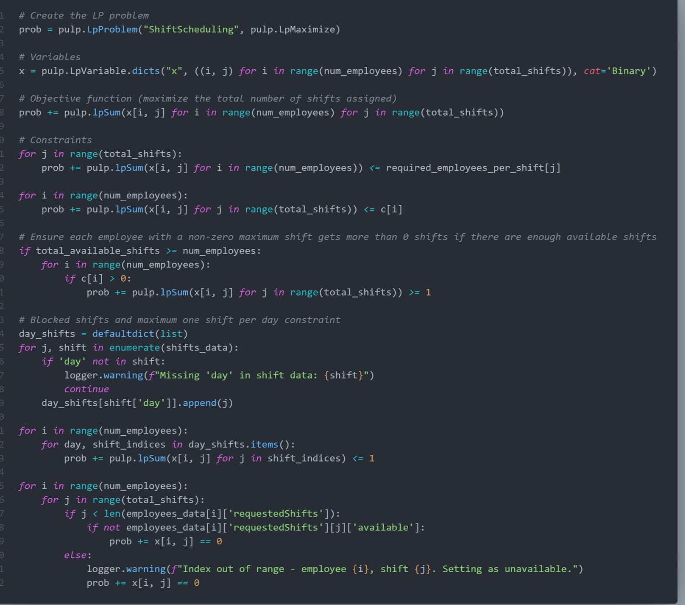

The Scheduling Algorithm
Source Code
Constrains
Ensure that each employee does not exceed their individual maximum allowable shifts.
Ensure that employees are only assigned to shifts they have requested and marked as available, ensuring no assignment to shifts beyond the employee's requested shifts.
And more…
Ensure that for each shift, the number of assigned employees does not exceed the required number of employees per shift.
Ensure that each employee can only be assigned to one shift per day and manage blocked shifts.

